Slide 1
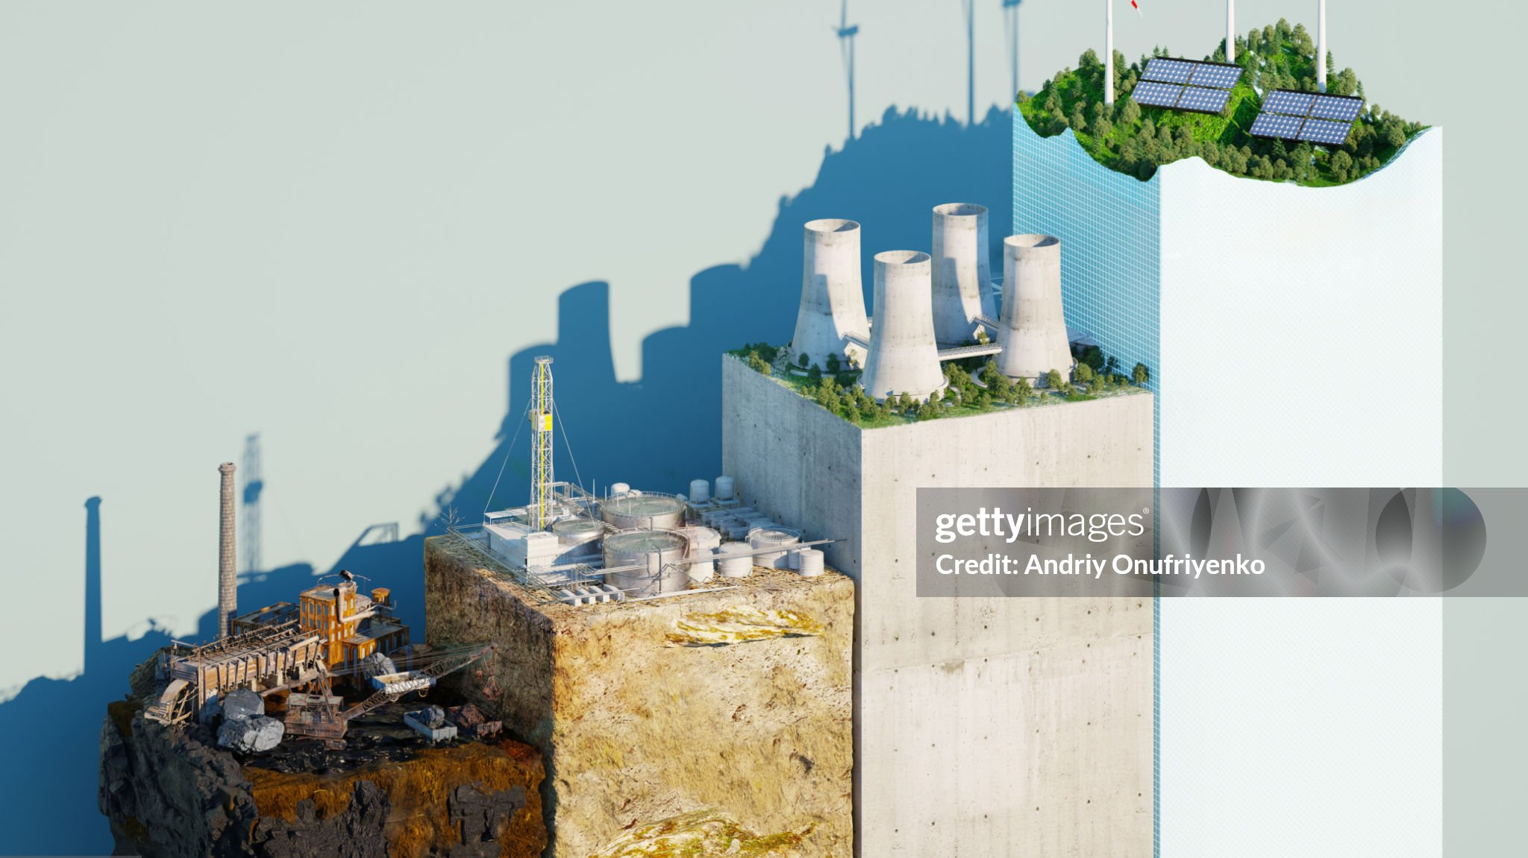
Welcome to My Presentation
Presented by Swarnali Akter

Slide 2

Topic: Global Warming and Its Effect on Weather Patterns
Key-words
Introduction
The Science of Weather Patterns
Global Warming's Impact on Weather
Case Studies of Extreme Weather
Long-Term Consequences
Conclusion

Slide 3
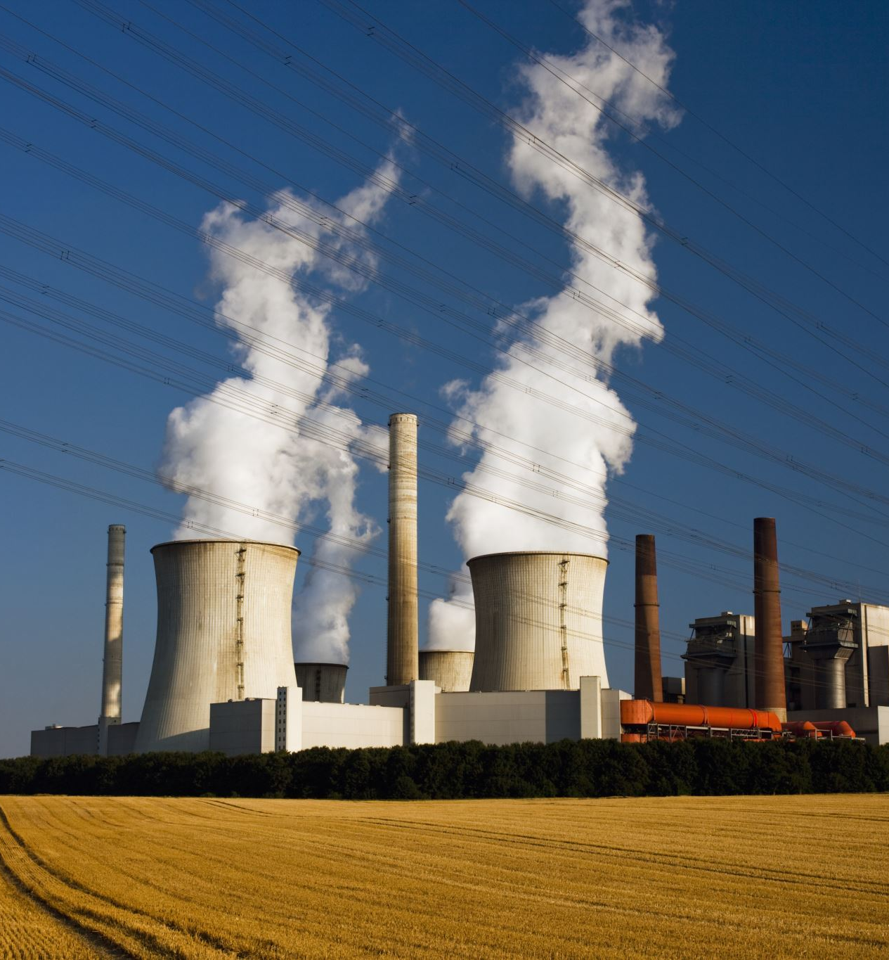
Introduction:
Definition: Global warming refers to the long-term increase in Earth's average surface temperature due to human activities, particularly the burning of fossil fuels (coal, oil, and natural gas).

Slide 4
The Science of Weather Patterns
Increased Frequency of Extreme Weather:
Heatwaves: More frequent and intense, putting strain on water resources and agriculture.
Storms: Hurricanes, typhoons, and cyclones are becoming stronger due to warmer sea surface temperatures.
Flooding: More intense rainfall leads to frequent floods, particularly in areas with poor drainage systems.
Droughts: Extended periods of drought are affecting agriculture, particularly in arid regions.

Slide 5
Ecology Infographic
ECOLOGY INFOGRAPHIC
RECYCLABLE
RENEWABLE
WATER PURIFICATION
DEGERTIFICATION
WEATHER
ENVIRONMENT
ECOLOGY
INFOGRAPHIC
ALTERNATIVE ENERGY
CARBON CYCLE
OZONE LAYER
VIRGIN FOREST
WEST RECYCLING
BOTANY

Slide 6
Bar Graph Of Human Contributors to Climate Change

Slide 7
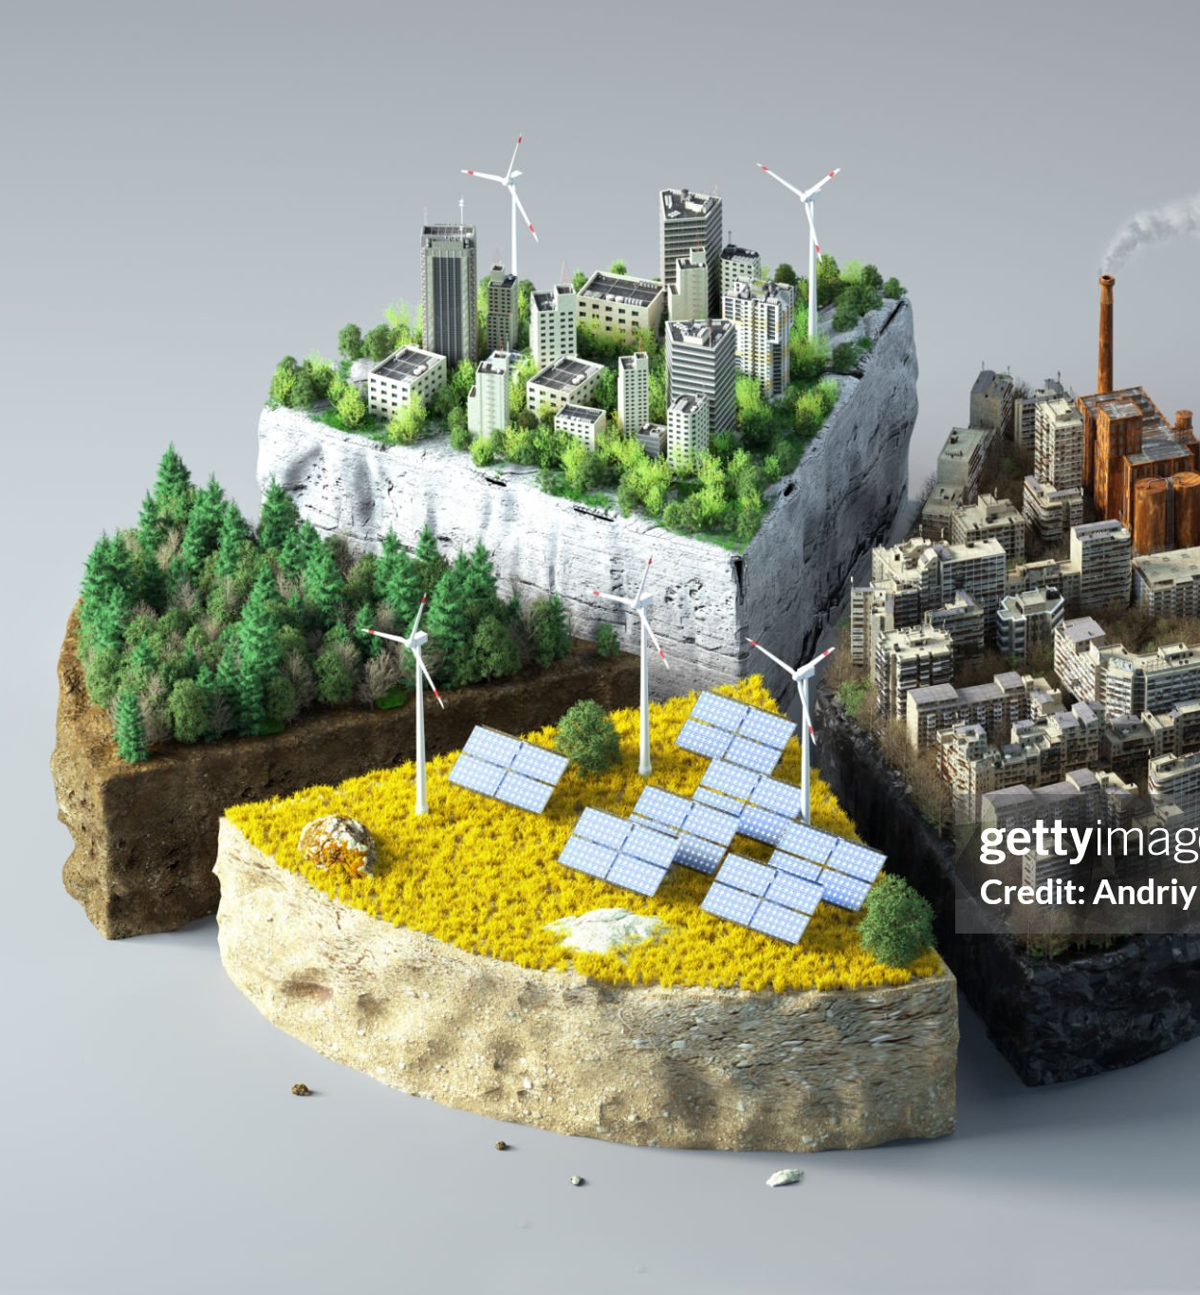
Worldwide Scenario of Global Warming
Rising temparature
Green House gas emission
Effects on the agriculture
Increase air soil and water pollution

Slide 8
THANK YOU

